Slide 1


Hamka
By Wolf

Slide 2
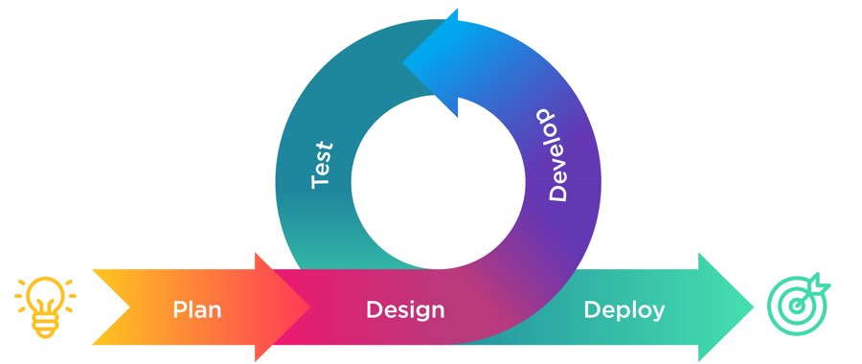
Development Process
Software Requirements Specification (SRS).
Software Development Plan (SDP) & Wireframe .
Agile Methodology.
Three Iterations.
Team of 4: 1 Product Owner, 2 Devs, 1 ScrumMaster.
Scrum Reports.
Testing.

Slide 3





Technologies we've used
Eclipse
Junit Testing
Scene Builder
JAVA FX, FXML
Git
White Box Testing
Black Box Testing

Slide 4

Design Patterns
Façade Pattern
Factory Pattern
prototype pattern
MVC
Singleton

Slide 5






Team Communication
Zoom Meetings.
Virtual meetings.
WhatsApp - WhatsApp group for updates .
Google Drive- share files.
Email- share data and files.
Team Viewer.

Slide 6

challenges we’ve overcome
Few and limited virtual meetings between team members because of the corona virus.
Tight Schedule.
Integrate design patterns in the code after writing it.
Issues With Executable Jar & Resources.
Switching roles between iterations and in particular continuing to implement code written by another team member.
Problems with the workspace.

Slide 7

Things we've learned
Work in Scrum software development methodology.
Unit Testing.
Work under pressure.
Back everything up.
Teamwork.

Slide 8
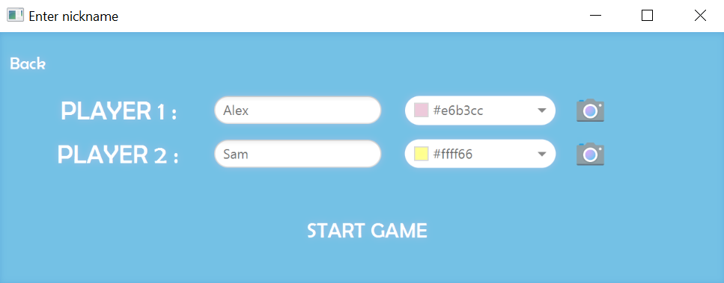
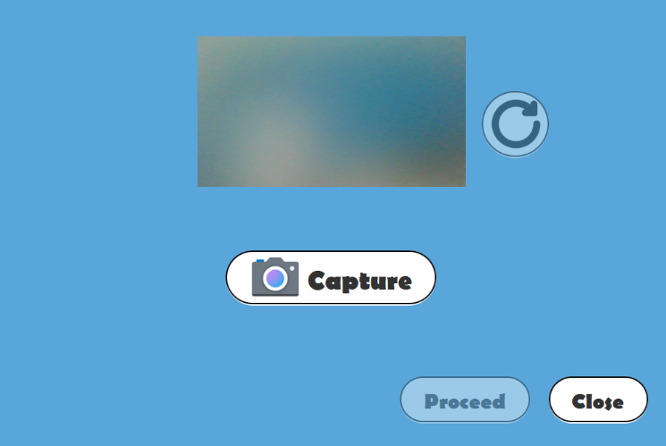

Features we’ve added 🤩
By clicking on the cam icon
You can take a picture of you
And on clicking procced the pic will be shown on the play screen

Slide 9
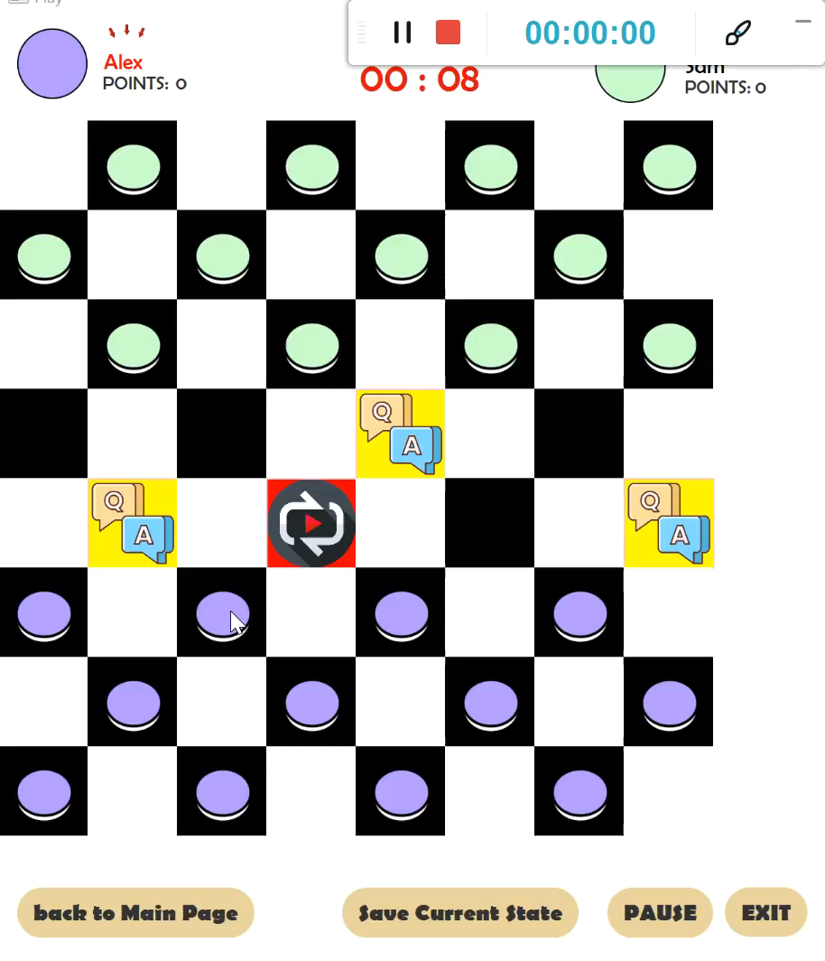
And… 😇 😉
We’ve added sound effect
Click play to see the feature

